Slide 1
Secure Data Hiding in Image Using Steganography
CAPSTONE PROJECT
Presented By : Mohammad Zeeshan Hyder
Student Name : Mohammad Zeeshan Hyder
College Name & Department : Siddhartha Degree College

Slide 2
OUTLINE
Problem Statement
Technology used
Wow factor
End users
Result
Conclusion
Git-hub Link
Future scope

Slide 3
Problem Statement
In the modern age of digital technologies, protecting sensitive information must be well-protected. This project is used for hiding data in images to ensure security without arousing suspicion using steganography. The goal of this project is to create an easy yet extremely effective method for securely passing on confidential information without compromising privacy and discretion.

Slide 4
Technology used
This project is Python-oriented and can support libraries like OpenCV for image processing and NumPy for handling efficient data. Certain cryptography libraries are also used to provide security. Development can be done using Jupyter Notebook or any IDEL that is supported by Python.

Slide 5
Wow factors
This project is stands in because it conceals information in images without degrading them, and it is difficult to identify, and it can hide information in images called as secret message, which means detection becomes very hard. It provides security by encrypting the data before embedding, which is an added security feature. The process is effective, easy to use, and accommodates many image formats, making it easier than common steganography methods.

Slide 6
End users
This project is beneficial to cybersecurity professionals, journalists, and activists who require a safe method of transferring sensitive information. It is also beneficial to intelligence organizations and government organizations for clandestine communication. Moreover, privacy individuals can utilize this process to guard personal information from unauthorized access.

Slide 7
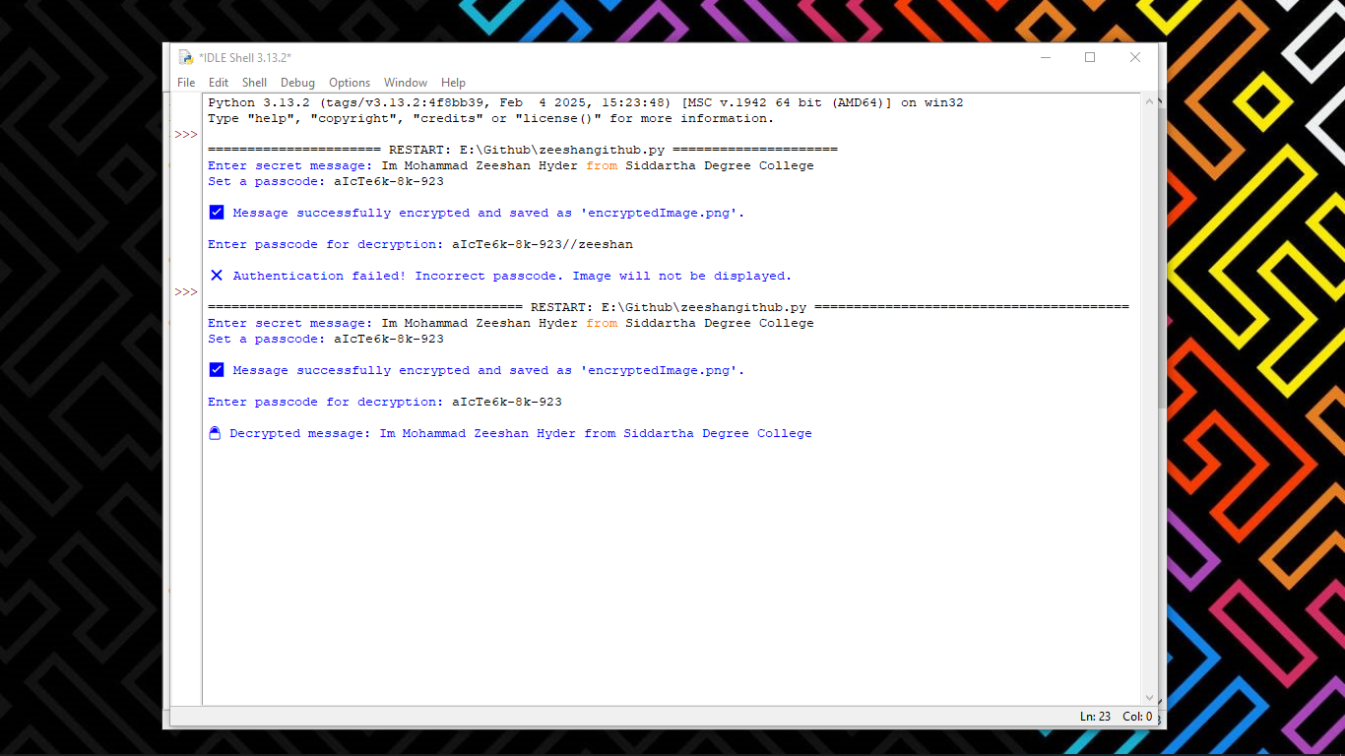
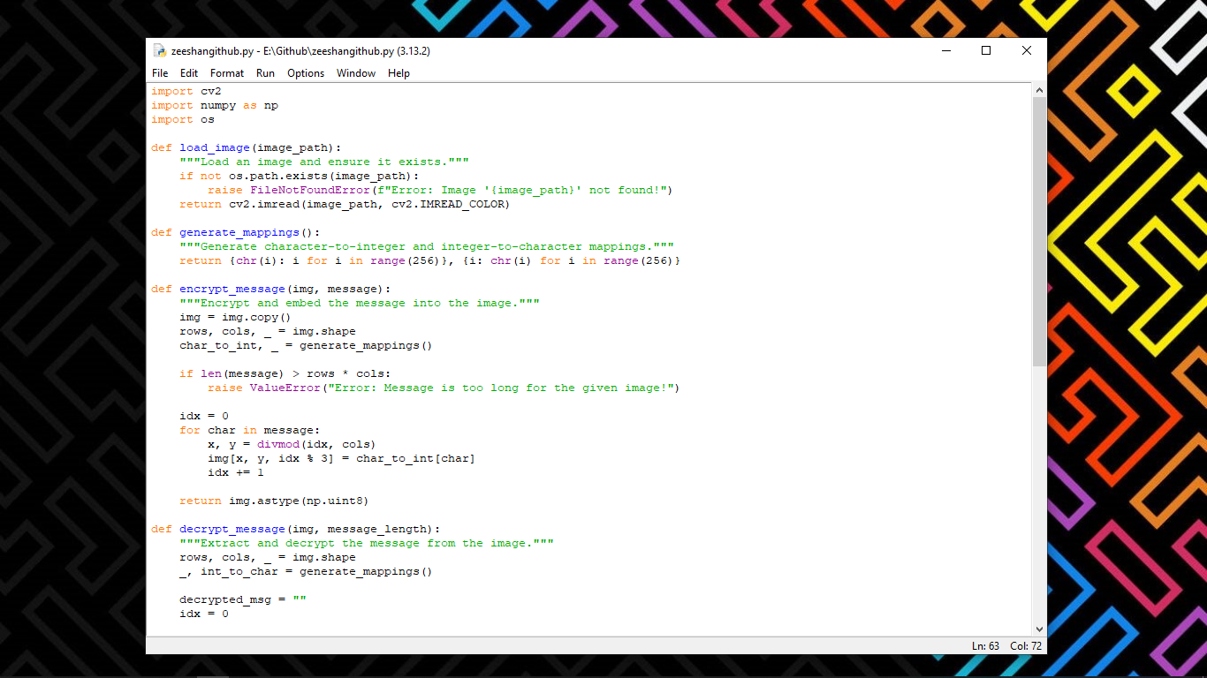
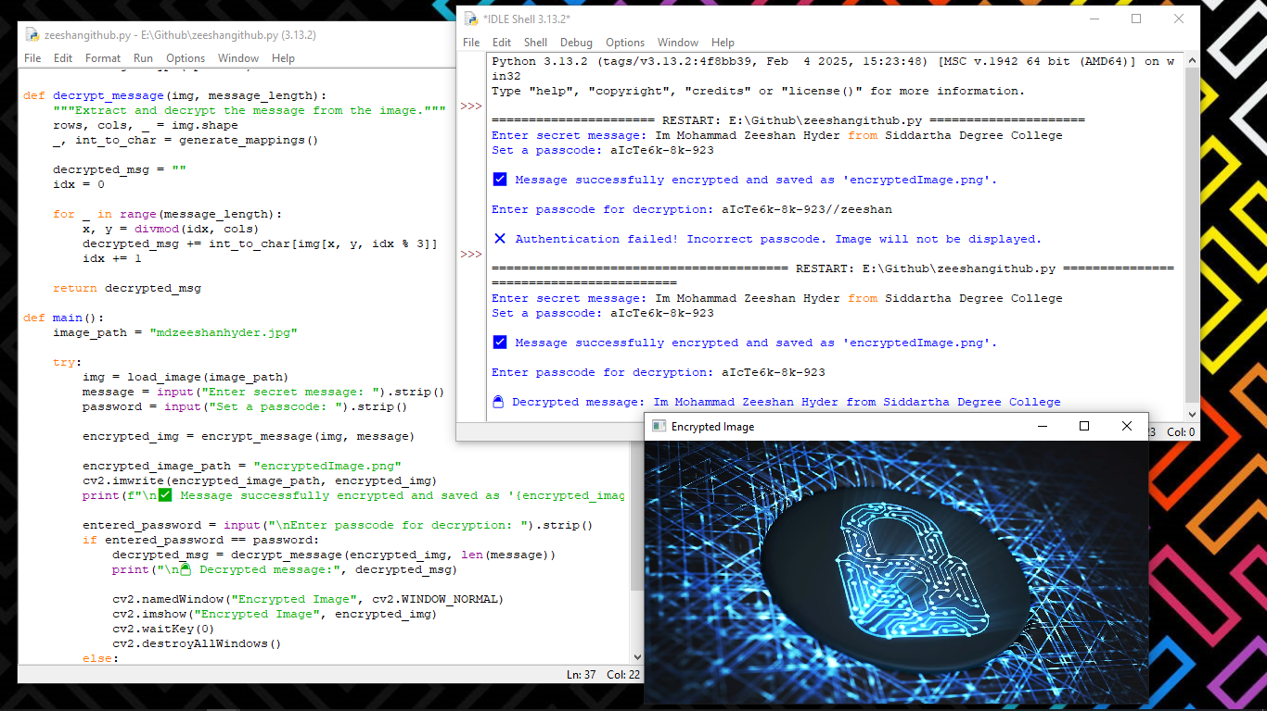

OUTPUT

Slide 8
Conclusion
This project can be expanded with more sophisticated encryption techniques to further increase the security. It can also be expanded to include support for steganography in video and audio, thereby making it more universal in its usage. Additionally, the use of AI-based algorithms can ensure that the embedded data can't be found by existing steganalysis tools. To ensure ease of use, a basic desktop or web application can be developed, and even non-technical individuals can easily embed and extract sensitive data securely.

Slide 9
GitHub Link
https://github.com/Zeeshan-hyder-git/Steganography.git

Slide 10
Future scope
This project is an easy yet efficient method to conceal sensitive data within images through steganography.The concealed data remains safe and nearly undetectable while maintaining the quality of the image. With encryption, it provides an added layer of security, making it even more secure. This process can be applied to secret communication, cybersecurity, and safeguarding valuable information from being accessed by unauthorized persons. It's generally a smart and pragmatic means to transmit secret messages without arousing suspicion.

Slide 11
THANK YOU

